Slide 1
Outline
Architecture of Slurm
Introduction: Batch System
Terminologies
Necessity
Component
Slurm (Batch system software's )
Slurm Entities
Slurm Architecture
Slurm Commands
Resource Availability
AIRAWAT-PSAI Cluster Partitions
Node States

Slide 2
Outline
Job Submission
Slurm Directives
Monitoring and Control
Job States
Job Pending Reasons
Job Control

Slide 3
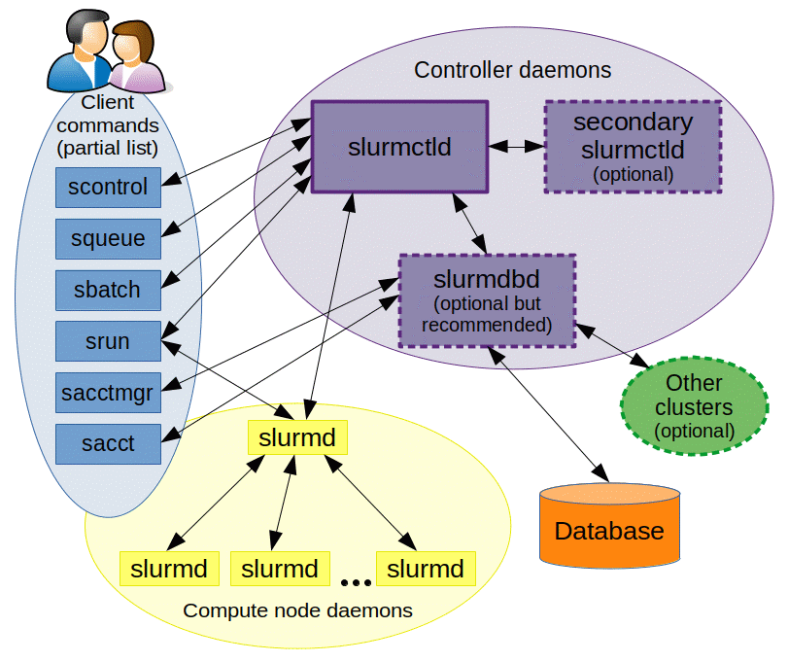
SLURM Architecture

Slide 4
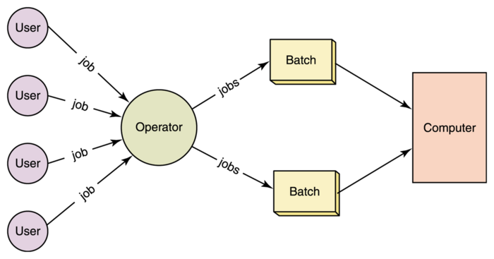
Introduction: Batch System
Batch processing is the execution of a series of jobs in a program on a computer without manual intervention (non-interactive).
The term originated in the days when users entered programs on punch cards. They would give a batch of these programmed cards to the system operator, who would feed them into the computer.
Batch scheduling system (HPC-AI Cluster)
Resource management
Scheduler
Usage accounting

Slide 5
Terminologies
Compute Node: individual computer with certain specs (CPUs, RAM, etc.)
login node: special node for accessing cluster and submitting jobs
Cluster: set of interconnected compute nodes
Partition: distinct group of compute nodes within a cluster
Terminal: program for running shells
Shell: program for running commands
Script: text file with a sequence of commands to execute
Job: distinct set of computational work to be performed
Job Steps: Job steps involve breaking down a larger task into smaller units for better organization, parallel execution, and resource allocation.
Scheduler: program that controls when and where jobs are run on a cluster

Slide 6
Necessity
Why we require the batch scheduling system
A broker system
It gives more control on jobs
The idle time batch system is very less.
Can put reservation for jobs.
Overall maximum utilization of cluster time

Slide 7
Components
Scheduler
Make scheduling decision based on polices
Resource manager
Spawn jobs
Copy the data
Accounting system
Limit threshold of resource
Keep tack of resources

Slide 8
What is SLURM
Open-source management and job scheduling system for Linux computing clusters
Three main functions of Slurm
Allocates access to resources (compute nodes)
Provides a framework to run and monitor jobs on allocated nodes
Manages a job queue for competing resource requests

Slide 9








Slurm Entities
Job
Step
Job
Partition 1
Job
Step
Job
Step
Job
Partition 2
>
Nodes
>
Partitions
>
Jobs
>
Job steps

Slide 10
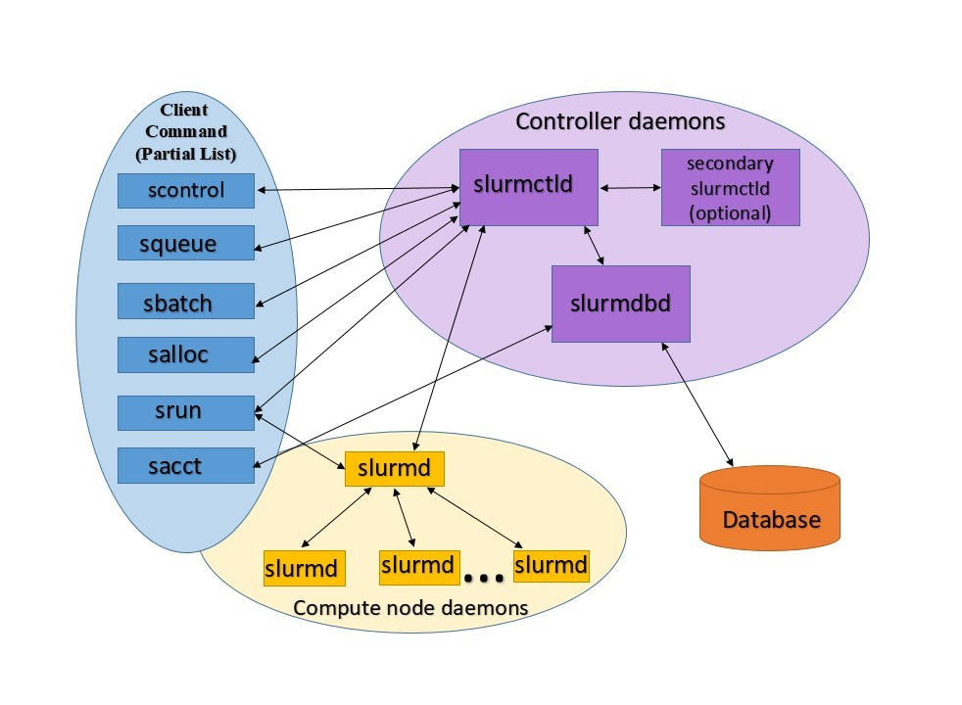
Slurm Architecture

Slide 11
Slurm Commands
Commands | Syntax | Description
sbatch | sbatch [options] batch_script | Submit a batch script as a job.
salloc | salloc [options] | Allocate resources for an interactive job.
srun | srun [options] | submits job for execution or initiate job steps in real time
squeue | squeue [options] | View the status of jobs in the queue.
scancel | scancel [options] job_id | Cancel a submitted job.
sinfo | sinfo [options] | View information about the cluster's partitions and nodes.
scontrol | scontrol [options] command | Control Slurm daemons and other administrative tasks.
sacct | sacct [options] | View job accounting information.

Slide 12
Resource Availability
Evaluating Resource Availability
Assessing Available Resources for Job Allocation.

Slide 13
sinfo
Display compute partition and node information
Default output lists information by partition and node status
nodeinfo lists information by partition, node type, and node status
sinfo --help
https://slurm.schedmd.com/sinfo.html
Syntax: sinfo
Examples:
$ sinfo
$ sinfo -lNp dgxnp

Slide 14
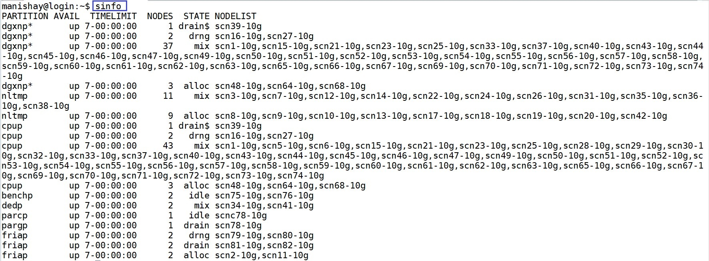
sinfo

Slide 15
AIRAWAT-PSAI Cluster Partitions
Partition Name | Description
dgxnp | Jobs requiring access to the GPUs in addition to CPUs
cpup | Jobs requiring access to only CPUs and no GPUs

Slide 16
Node States
Name | Code | Explanation
allocated | alloc | The node has been allocated to one or more jobs
down | down | The node is unavailable for use
draining | drng | The node is currently executing a job, but will not be allocated additional jobs
drained | drain | The node is intentionally taken offline and not accepting new tasks.
idle | idle | The node is not allocated to any jobs and is available for use
maint | maint | The node is currently in a reservation with a flag value of "maintenance"
mixed | mix | The node has some of its CPUs ALLOCATED while others are IDLE
reserved | resv | The node is in an advanced reservation and not generally available

Slide 17
Job Submission
Users submit jobs to the SLURM system.
Jobs specify resource requirements, like number of nodes, cores, and expected runtime.
SLURM queues the jobs and schedules them for execution based on availability and priorities.
Three commands are available for users to submit their jobs :
sbatch
salloc
srun

Slide 18
Slurm Directives
Directives | Syntax | Description
Partition | #SBATCH --partition=partition_name OR #SBATCH –p partition_name | Specify the partition to submit the job.
Wall time | #SBATCH --time=days-hours:minutes:seconds OR #SBATCH –t days-hours:minutes:seconds | Set the maximum wall time for the job.
Node count | #SBATCH --nodes=No_of_nodes OR #SBATCH -N No_of_nodes | Number of compute nodes for the job.
Job name | #SBATCH --job-name=jobname OR #SBATCH –J jobname | Set a name for the job.
Total tasks count | #SBATCH --ntasks=num_tasks OR #SBATCH -n num_tasks | Number of tasks (CPUs) required for the job.
Task per node | #SBATCH --ntasks-per-node=tasks_per_node | Number of tasks to be allocated per node.
CPU per task | #SBATCH --cpus-per-task=number_of_cores | Number of CPU cores required to each task of a job.
GPU Count | #SBATCH --gres=gpu:A100-SXM4:No_of_gpus | Request for specific GPU
Stderr | #SBATCH --error=job.%J.err OR #SBATCH –e job.%J.err | File to redirect standard error.
Stdout | #SBATCH --output=job.%J.out OR #SBATCH –o job.%j.out | File to redirect standard output.

Slide 19
sbatch
Submit a job script for remote execution
A job script is a special type of Bash script
sbatch –help
https://slurm.schedmd.com/sbatch.html
$sbatch job.sh

Slide 20
Commonly used salloc/sbatch options
Option | Description | Default values
--nodes=<number> | Number of compute nodes for the job. | 1
--ntasks=<number> | Number of tasks (CPUs) required for the job. | 1
--cpus-per-task=<number> | Number of CPU cores required to each task of a job. | 1
--time=<D-HH:MM:SS> | Set the maximum wall time for the job. | 01:00:00
--partition=<partition_name> | Specify the partition to submit the job. | dgxnp

Slide 21
Job limits
Partition | dgxnp | cpup
One Node | 8 GPUs, 192 core | 64 cores
number of nodes | 40+ | 45+
number of cpus | 7680+ | 2048+
No of GPUs | 320 | n/a
Maximum number of jobs running | 8 | 8
No of tasks per node | 192 | 64
No of GPUs per node | 8 | n/a
Wall Time | 7 days | 7 days

Slide 22
Environment variables for sbatch
Variable | Description
SLURM_JOB_ID | The ID of the job allocation
SLURM_JOB_NODELIST | List of nodes allocated to the job
SLURM_JOB_NUM_NODES | Total number of nodes in the job's resource allocation
SLURM_NTASKS | Number of tasks requested
SLURM_CPUS_PER_TASK | Number of CPUs requested per task
SLURM_SUBMIT_DIR | The directory from which sbatch was invoked
SLURM_ARRAY_TASK_ID | Job array ID (index) number

Slide 23
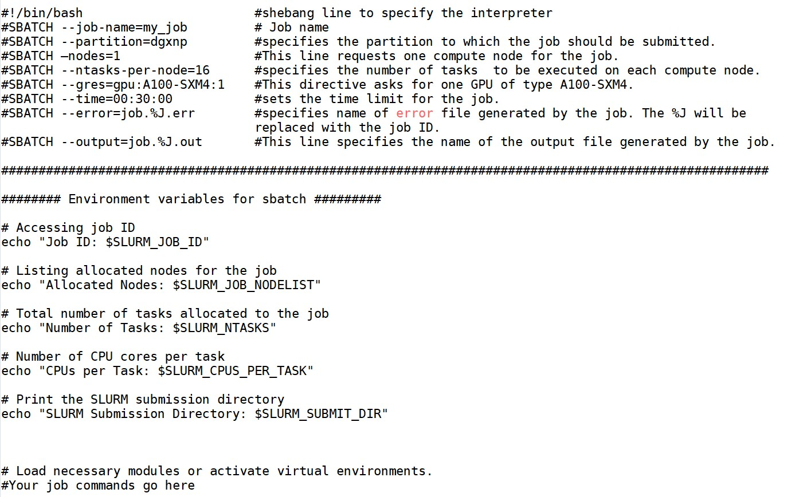
Sample Batch Script

Slide 24
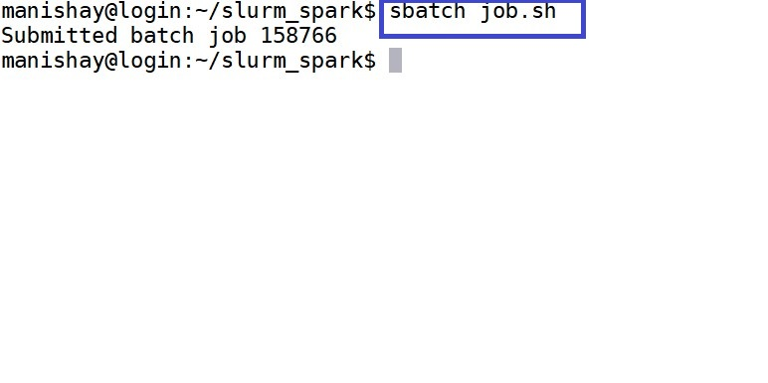
Job Submission Using sbatch

Slide 25
salloc
Allocate resources for an interactive job
Useful for development and debugging
Similar options to sbatch
salloc --help
https://slurm.schedmd.com/salloc.html
$ salloc
$ salloc --nodes=1 --ntasks-per-node=128 --gres=gpu:A100-SXM4:8 --time=00:50:00

Slide 26
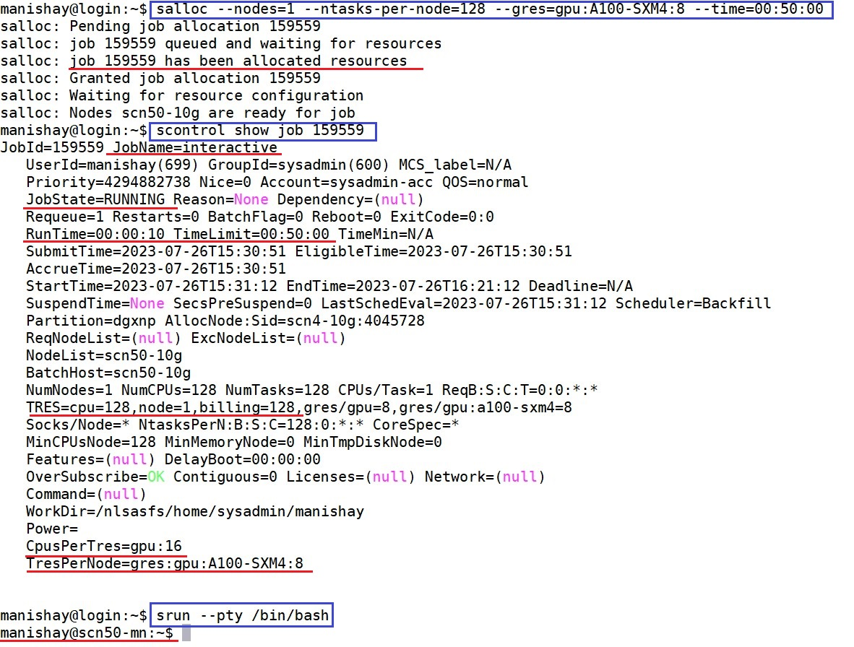
salloc
salloc: Command used to obtain an interactive allocation of resources in Slurm, allowing users to execute commands directly on allocated nodes.

Slide 27
srun
Launch parallel tasks (job steps) for MPI jobs
Can also be used for job packing
srun is used for interactively debugging parallel or multi-node programs
srun --help
https://slurm.schedmd.com/srun.html

Slide 28
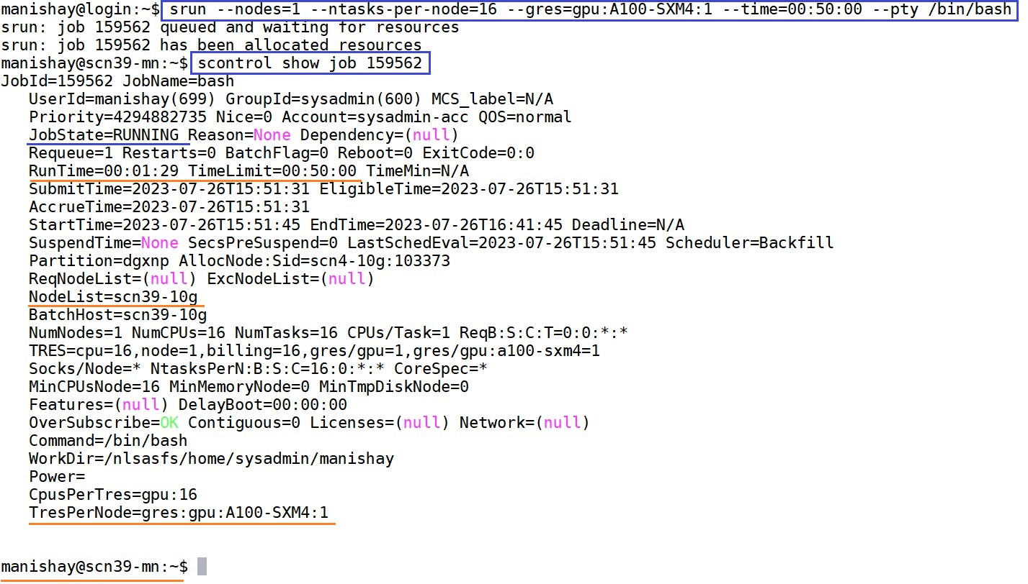
srun
When resources are explicitly mentioned.

Slide 29
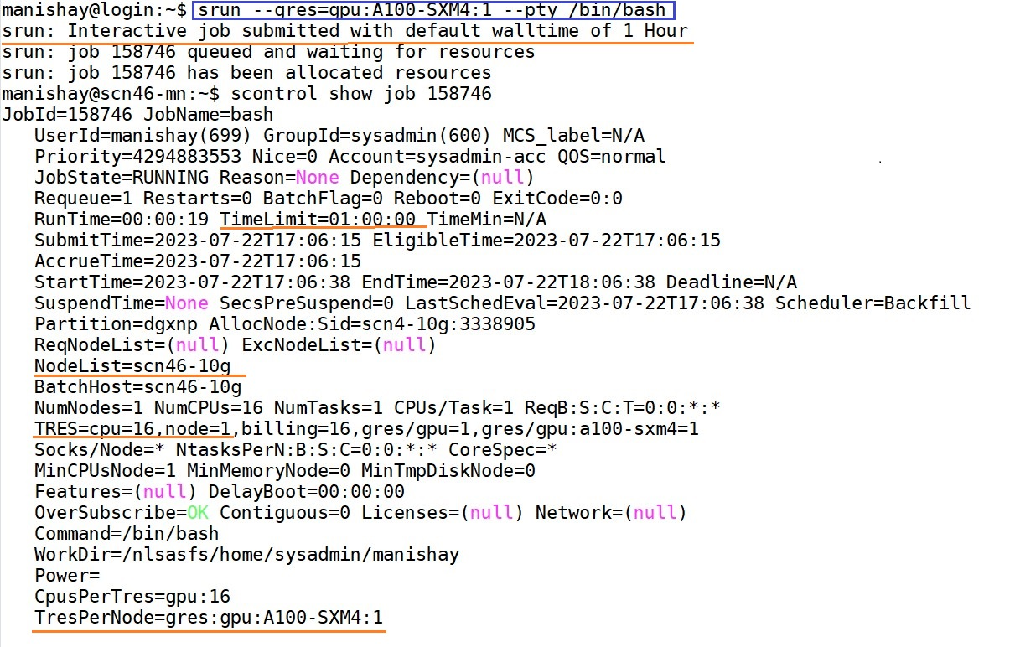
srun
When resources are not mentioned while submitting the job.

Slide 30
Monitoring and Control
SLURM provides tools to monitor job status, resource usage, and cluster health.
Users can check job status using commands like squeue or sacct.
Administrators can manage the cluster, modify policies, and control job execution.

Slide 31
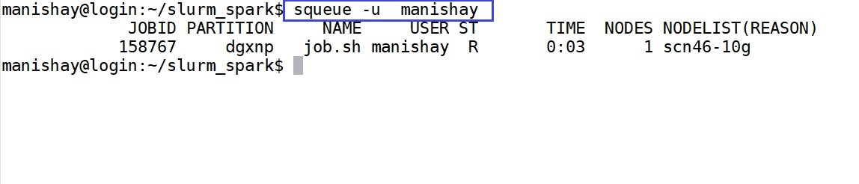
squeue
squeue is used to monitor the status of jobs in the Slurm job queue
Syntax: squeue [options]
Examples:
squeue: Show the status of all jobs in the queue.
squeue -u username: Display jobs for a specific user.

Slide 32
Job States
Status | Code | Explanation
COMPLETED | CD | The job has completed successfully.
COMPLETING | CG | The job is finishing but some processes are still active.
FAILED | F | The job terminated with a non-zero exit code and failed to execute.
PENDING | PD | The job is waiting for resource allocation. It will eventually run.
RUNNING | R | The job currently is allocated to a node and is running.

Slide 33
Job Pending Reasons
Reason | Explanation
Resource | The job is waiting for resources to become available
Priority | One or more higher priority jobs exist for this partition or advanced reservation
ReqNodeNotAvail | Some node specifically required by the job is not currently available
InvalidAccount | The project account is invalid
Job Dependencies | The job has dependencies on other jobs that are still running or pending.
Time Limit | The job's requested time exceeds the available time on the cluster or the limit set.
Cluster Maintenance | The cluster is undergoing maintenance, and no jobs can run during this time.
Fair Share Policy | User's fair share of cluster resources has been consumed, causing a delay in execution.

Slide 34
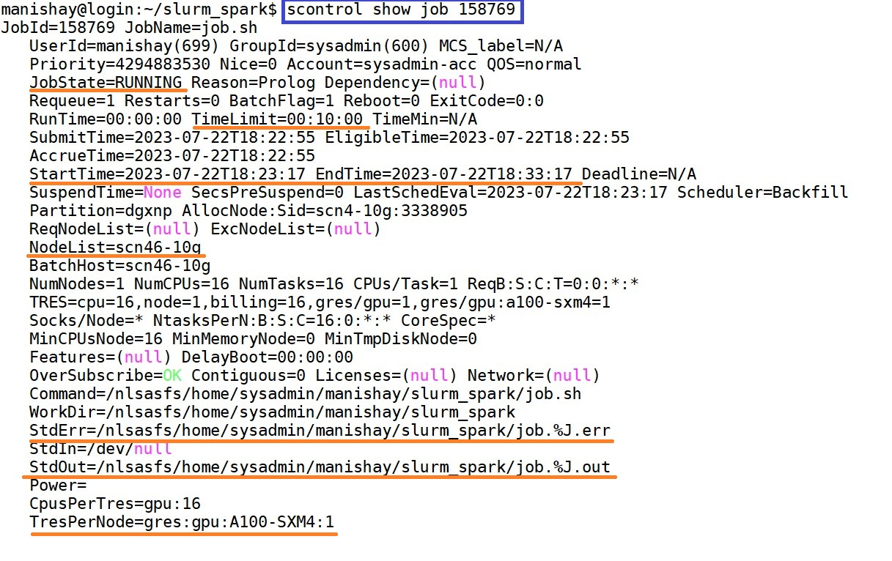
scontrol

Slide 35
scancel
Cancel pending or running jobs
scancel --help
https://slurm.schedmd.com/scancel.html
Syntax: scancel job_id
Examples:
scancel 12345: Cancel a job with the specified job ID.
scancel –u username: Cancel all jobs for a specific user.

Slide 36
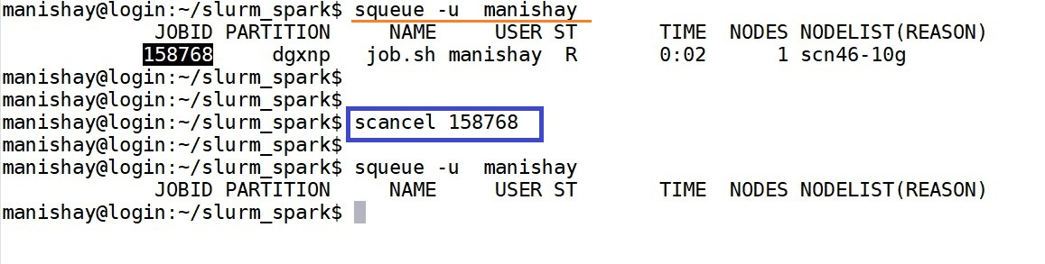
scancel

Slide 37
Monitoring Jobs
sacct — view information about current or past jobs
sstat — view job status for currently running job

Slide 38
sacct
Display accounting information for jobs
sacct –help
https://slurm.schedmd.com/sacct.html
$ sacct
$ sacct -j <job_id>
$sacct -j 158243 --format=JobID,JobName,Start,End,CPUTime,AllocTRES

Slide 39
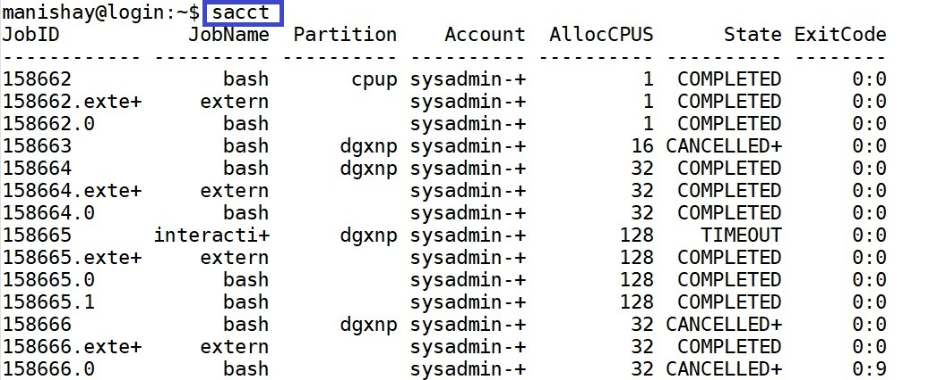
sacct

Slide 40
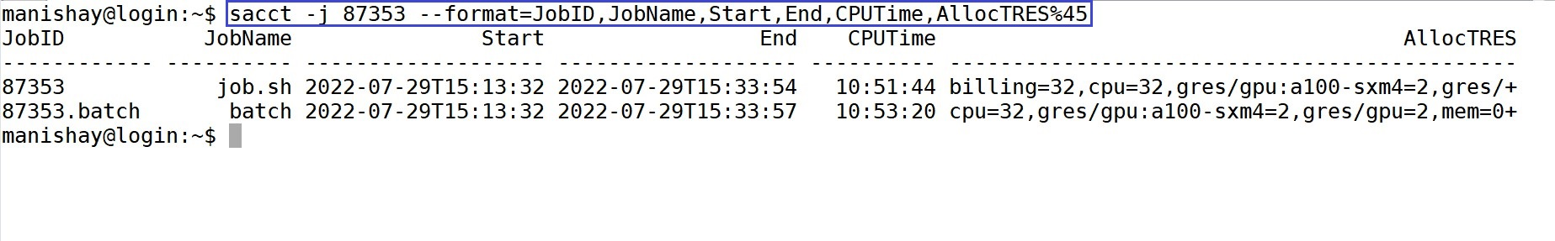
sacct

Slide 41
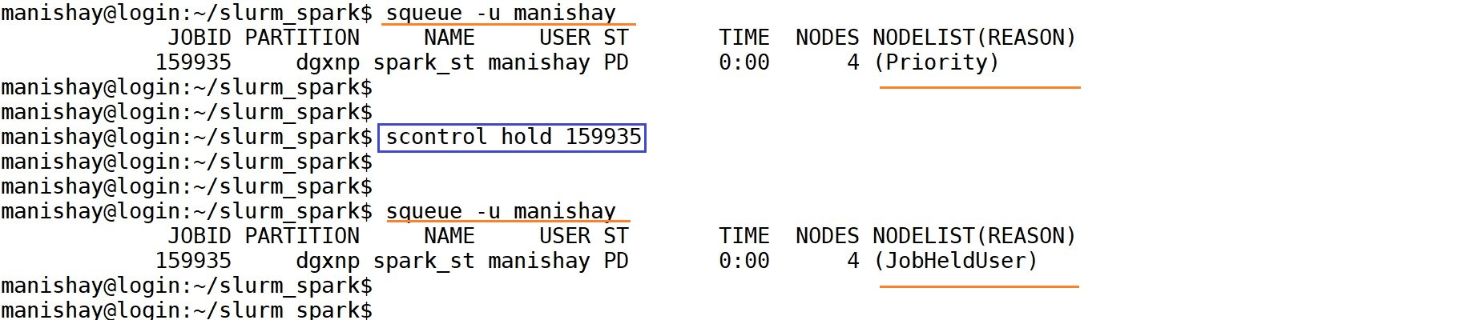
Job Control
The scontrol hold job command allows users to place a submitted job on hold.
Syntax: scontrol hold job_id
Examples:
$ scontrol hold 158436: Holds a job with the specified job ID.

Slide 42
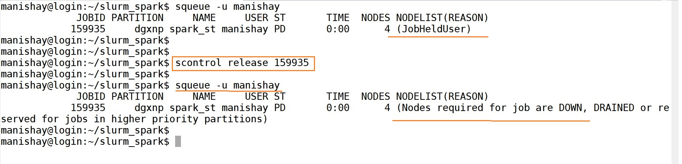
Job Control:
The scontrol release job command removes the hold state from a job, allowing it to start its execution
Syntax: scontrol release job_id
Examples:
$ scontrol release 158436: Releases the job held with the specified job ID.

Slide 43



Thank You !

